Slide 1
With vast amounts of funding at disposal, they went all out with the hiring, scaling, and expansion process irrespective of the capacity. This lazy approach resulted in operations in 11 cities with about 600 employees.
the company had to shut its services due to the company’s failure in managing money.
There may be many who are not aware, but Tiny Owl’s sad demise was a lesson to be learned from one of the biggest startups in the Indian economy. The company shut down in 2016 when it was acquired by Roadrunnr. However, unlike many other companies, it’s failures cannot be credited to external factors. TinyOwl was eaten from the inside.

Slide 2
Background & Main IDEA
TinyOwl was founded by five IIT alumni in the year 2014.
The main idea behind incubating a platform like TinyOwl was to create value for all stakeholders in the restaurant and food ecosystem that includes the restaurant owners, staffs, suppliers and of course, the consumers. The restaurant owners’ benefit, making the app a potent marketing tool for them as they can target users based on location and preferences.

Slide 3
FUNCTIONALITIES
The app provided not just the food menus, it describes each dishes and provides you with the chef’s profile. Suggestions based on your past choices were also provided.
Coming to service, the app did almost everything it could. It’s a simple and friendly user interface, the constantly updated menus and prices, everything made the app easy, convenient and reliable to use.
When you open the app, it detects your location and gives you a list of nearby restaurants. You can then choose your dishes/cuisine from the menu and place the order by providing details on where to find you. You have options to pay via card/cash. It also gives you the convenience of tracking the delivery.

Slide 4
GOOD OLD DAYS
Their primary focus was only on growth. Though there was an increase in orders for the restaurants, the TinyOwl app was free for its users as well as the restaurants.
In the same year of its formation, TinyOwl raised 100 crores in the second round of funding for expanding its food ordering business across 50 cities by year-end and to hit the top 10 cities by the middle of next year.
TinyOwl reached more than 4,000 restaurants listed on its platform, with about 2,000 daily orders. It now gets a 10–20 percent commission from restaurants when an order is placed through its app.

Slide 5
ARM OF TINY OWL
It then launched a ‘TinyOwl Homemade’ app which gives you access to food from home chefs. The homemade app gives you the choice of having home-cooked food lets you reach the nearest home chef in your locality. The homemade app functioned in some parts of Mumbai with a plan to stretch its service eventually to other cities.

Slide 6
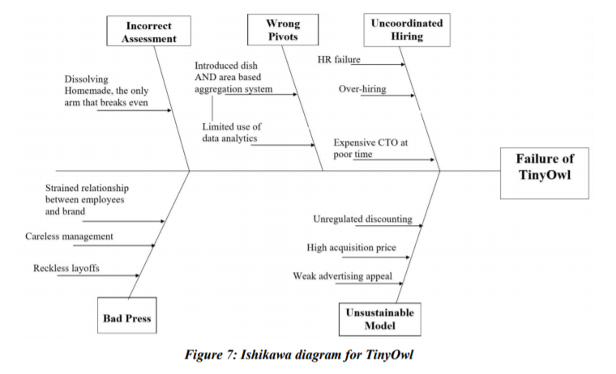

Slide 7
Huge acquisition costs: As traditional knowledge in the food-tech sector suggests, initial cash burn marketing tactics should be used to bring in consumers and make presence visible. However, TinyOwl spent a huge amount of money on customer acquisition causing huge cash burn.
• Dish-based aggregation failure: TinyOwl introduced a dish-based aggregation system (the app would display a particular ‘dish of the day’, followed by the places which served that dish). The attempt tanked with only three orders a day. This was attributed mainly to a lack of data analytics and artificial intelligence unable to gauge or handle the consumer market.
• Area-based aggregation failure: Introduction of a model that on an order of say coke, fries and burgers, would get all three from different restaurants. The scalability of the model was under question. The large logistical costs of the move were unrecoverable.
Dissolution of only profit making arm: Homemade was TinyOwl’s amateur chef aggregation business and an entry into Fast Food 2.0. The only competition at the time was Holachef, and it was the only profit making arm of the parent company.
• Sudden retrenchment and failure of HR policy: Layoffs of more than half the workforce and giving out post-dated checks to employees created a bitter aftertaste. The bad press surrounding the mismanagement of employees did not help TinyOwl’s case.
• Competition: At the time of TinyOwl’s entry, rival aggregator Foodpanda started heavy discounting (including discounts of ₹250 for a minimum order of ₹400). TinyOwl was not able to keep up

Slide 8
Ever since it committed the sin of over-hiring, it was preparing for its destruction. Over-hiring is a common mistake with startups.
Though it fired 300 employees in September 2015, the already hidden misfortune continued to haunt.
In November 2015, it initiated the second round of cuts. Mandad was advised not to retrench so close to Diwali. But the cuts were announced. And that was the second sin by TinyOwl.
It went to do a dish-based aggregation system. That was like if you open the app — it will tell you what’s today’s dish, and would give you options on where you could order it from.
The idea turned wrong due to lack of technical aspects. There was hardly any artificial intelligence used, no data analytics were there and the pivot tanked with just less than five orders a day.
At the end of 2015, TinyOwl made its sin number four. It hired a chief technology officer. Akash Saxena joined Tiny Owl as its CTO for Rs 1.5 crores a year and a joining bonus of Rs 50 lakhs.
Right at the beginning of 2016, it began preparation for sin number five — An area-based food aggregation, similar to what Grofers runs in the grocery.
In this model, TinyOwl had to pay for the logistics of gathering the food from various restaurants. That cost too much for the poor kid.
For the area-based food aggregation plan, more cash was required and all head of the departments were told to find new jobs. Thus Homemade, the only arm of TinyOwl broke and dissolved.

Slide 9
Only the Mumbai division was kept alive
With a negative profit margin, high costs of delivery and customer acquisition, the overstaffed and lavish offices began mass layoffs. It soon had to shut down operations in every city except Mumbai.
Later, the company reports said it would only be active temporarily in Mumbai. The app didn’t let users access restaurants listed either in Delhi or Bangalore, its two other big markets.
There was a split between the founders and they left to different places. The breakdown in the relationship between employees and founders was well visible.
Fundraising then became a nightmare for TinyOwl. Mandad approached investors from across the world. Nobody was keen on funding the company. He then started approaching its rivals to buy out a portion of the company.
After an all-stock deal with the logistics startup Roadrunner, In May 2016, TinyOwl announced its merger. The two companies had mutual investors Sequoia Capital and Nexus Venture Partners.
The merged company now called Runnr itself was facing operational problems. It currently operates in Bangalore and Mumbai. Due to the high costs of running an operations-heavy business, Runnr continues struggling for its existence in a market dominated by food tech giants like Swiggy and Zomato.
Thus the Mumbai-based food tech business flew high and fell deep on the back of a few bad decisions. It failed to sustain amidst of chaos.
There are many startups out there that had to withdraw on their midway. The rise and fall of TinyOwl set a lesson to be learnt for the Indian startup community. The challenges and inefficiencies in running an operations-intensive business were quite evident in its miserable fate.

Slide 10

In September 2015, TinyOwl had fired 100 employees in its Mumbai and Pune offices.
Tiny Owl and Runner two of the most well funded on-demand startups in 2015 havin having collectively raised more than $50 million from investors like Sequoia Capital, Nexus Venture Partners and Matrix Partners.
June 2016 Roadrunner acquired Tiny Owl, then rebranded itself as Runnr.
September 2017 Zomato acquired Runner for $40 million.

